Slide 1

Health Outcomes Across States: Evaluating the Impact of Insurance and Preventative Care
Karthika Prasad, Tammy Hardman, Katherine Gonzalez, Elaine McCall
Notes:
We are group 5, our project is titled: Health Outcomes Across States: Evaluating the Impact of Insurance and Preventative Care
Our group includes: myself, Tammy, Katherine, and Elaine
<next slide>

Slide 2
INTRODUCTION
Project Goal:
Our project aims to show the impact of health insurance on receiving care and overall health outcomes at the state level for the years of 2018-2019.
Relation to Healthcare Industry:
Premature mortality can explain relationship between the health and wealth of nations, healthcare accounts for 10 percent of gross domestic product (GDP) of most developed nations.
In a well-functioning health system, premature deaths (under the age of 75 years) can often be avoided through public health interventions and quality medical care. Our focus is on whether health insurance acts as a gateway to preventative care services that reduce premature mortality.
Notes:
Our project aims to show the impact of health insurance on receiving care and overall health outcomes at the state level for the years of 2018-2019.
How this relates to the healthcare industry:
Premature mortality can explain relationship between the health and wealth of nations, healthcare accounts for 10 percent of gross domestic product (GDP) of most developed nations.
In a well-functioning society deaths under the age of 75 years old can often be avoided. Analyzing the correlation between the status of health insurance, and premature mortality indicators is a resourceful approach for examining state health outcomes.
(Alternatively, read from slide) <next slide>

Slide 3
QUESTIONS TO ANSWER
01
02
03
Is there a correlation between the percentage of uninsured adults and premature mortality rates per state?
Which has more influence on health outcomes, not having insurance or not having a primary care provider?
What are the Top and Worst 5 state rankings?
Notes:
We aimed to answer three questions through data exploration and analysis: (Read questions from slide)
Next, Katherine will discuss our Data Collection process.
<next slide>

Slide 4
DATA COLLECTION
Data collected from: CDC National Vital Statistics System (NVSS)
Source: The Commonwealth Fund
Datasets used (5 csv files):
Percentage of Uninsured Adults (523 rows)
Percentage of Adults visit Primary Care Provider (524 rows)
Avoidable Deaths per 100k Population (160 rows)
Preventable Deaths per 100k Population (160 rows)
Treatable Deaths per 100k Population (160 rows)
Notes:
Initially, we attempted to use census data as a reputable source for the number of insured and uninsured per state, but it was too wide in scope and the format proved quite difficult to clean. Another difficulty was healthcare has a lot of privacy limitations, luckily we found The Commonwealth Fund, who sources their data from the CDC National Vital Statistics System (NVSS), which is a reputable source but with limited public access.
We wanted to explore healthcare outcomes, so we focused our efforts on how well states are doing at preserving liv` es, exploring premature mortality through avoidable, preventable, and treatable deaths.
Premature mortality refers to fatalities that occur before reaching the average age of death, which is 75 years old in the US. Avoidable deaths typically depends on preventable and treatable conditions. Preventable deaths are those potentially related to a lack of public health interventions, whereas treatable deaths relate to those that could’ve been averted with more timely care.
<next slide>

Slide 5
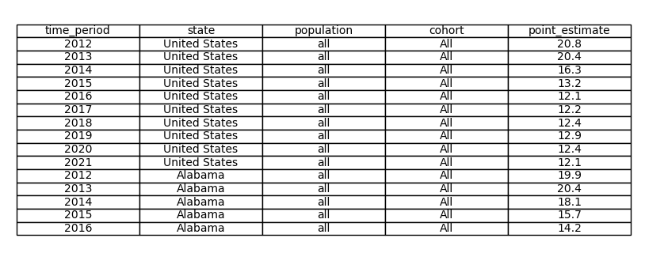
Initial look at a Dataset
Notes:
Our first initial look at our datasets that we pulled in looked like this.
Where we have multiple years for each location.
The name of the columns are the same for each dataset
We want to be able to pull in the data easily to analyze
Now for our cleanup process
<next slide>

Slide 6
CLEAN UP PROCESS
2018-2019
Two years of data are combined to ensure adequate sample size for state-level rates.
Two of the datasets had 2018 and 2019 separated, we averaged the years
The other three datasets had two combined years for data.
“Two years of data are combined to ensure adequate sample size for state-level rates” -The Commonwealth Fund
Why not 2020?
As 2020 brought in covid-19, we observed a jump in premature deaths vs 2018-2019 years.
Each dataset contained at least 52 rows for states - No empty (n/a) data
United States
taken out as having the average for the data - dropped based on index
50 States
Kept all, outliers are relevant
District of Columbia
Kept so we have a total of 51 “states”
Notes:
Now for our cleanup process/
After we did the initial read in of the CSVs and viewing the data
We narrowed down to the two years we will be looking at 2018 and 2019
A few things we had note of,
Of our five datasets, two of them had every year separated while the other three has them combined. We averaged the two years.
We renamed columns for ease of reading, as well as defera…. From one percentage to another.
We removed the United states as we are looking at individual states, well keeping in the District of Columbia,
We renamed columns, combined the datasets to one, and exported it to a CSV
Which brought it to look like this
<next slide>

Slide 7
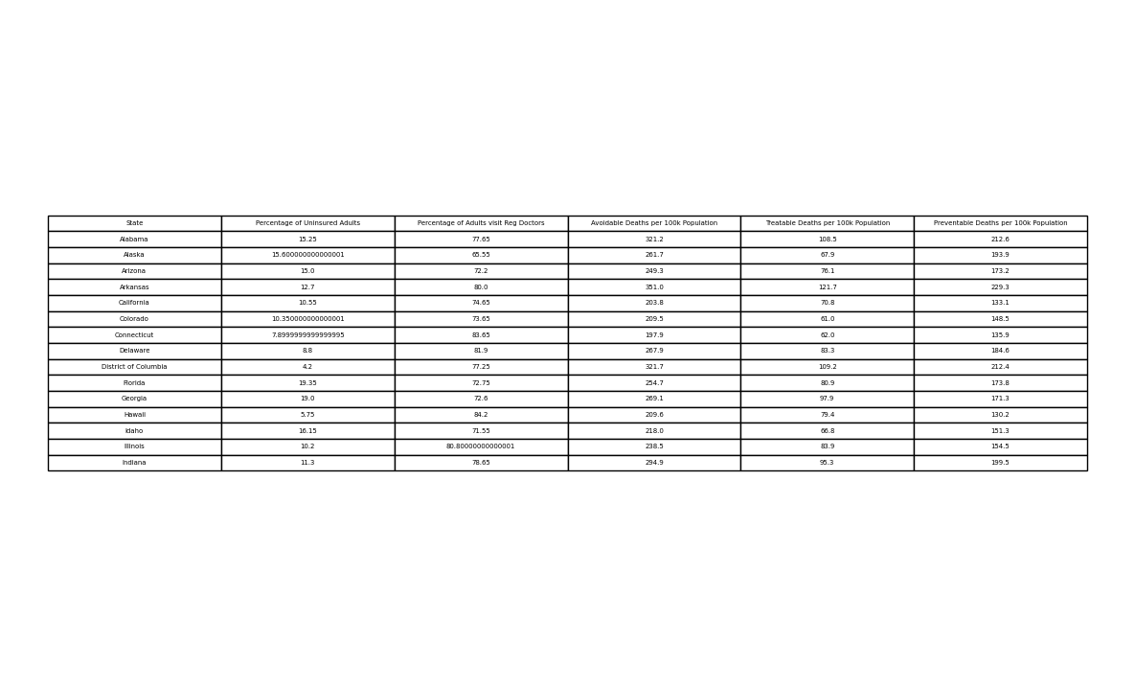
Dataset after Cleaning
Notes:
Our first initial look at our datasets that we pulled in looked like this.
Where we have multiple years for each location.
The name of the columns are the same for each dataset
We want to be able to pull in the data easily to analyze
Now for our cleanup process
<next slide>

Slide 8
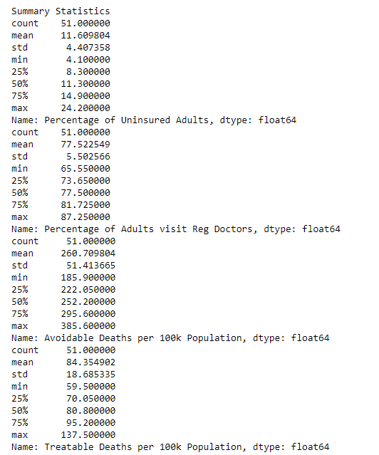

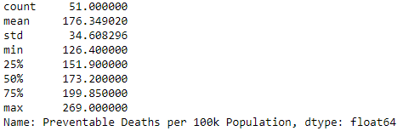
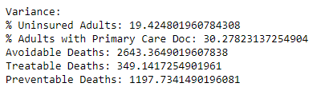
Exploratory Data Analysis (EDA)
The Pearson correlation coefficient (r) is the most common way of measuring a linear correlation. It is a number between –1 and 1 that measures the strength and direction of the relationship between two variables.
https://www.scribbr.com/statistics/pearson-correlation-coefficient/
Notes:
Thank you Tammy. We have two unique measurements within our datasets. While they are all separated by state, two are % based and three are based on per 100k population.
The datasets that are % based are limited in their minimum and maximum only have a possible range from 0 to 100. We can see the uninsured rates are on the lower end of that range, and the percentage of adults with PCP to be on the higher end of the range.
But both have relatively low variance compares to our 100k population datasets that are not nearly as limited on range.
For our premature mortality dataset with the 100k population measurement, outliers were expected here, and normal distribution of data wasn’t as important as the outliers should tell a story.
Now, the problem we had with these two different types of measurement is exploring how to compare the two. We could not do a 1:1 comparisons between percentage uninsured and premature deaths, so we explored correlation factors instead.
We settled on the Pearson correlation coefficient (often denoted as "r"). This correlation coefficient is well supported, it measures correlation between -1 to 1, the higher the absolute value of the number, the more the factors are correlated. The factors can be positively correlated, meaning if one factor occurs, the other is more likely. Or it can be negatively correlated, where if one factor is missing, the other is less likely to occur.
That brings us to our first question.
<next slide>

Slide 9
01
Is there a correlation between the percentage of uninsured adults and premature mortality rates per state?
Notes:
Is there a correlation between the percentage of uninsured adults and premature mortality rates per state?
<next slide>

Slide 10
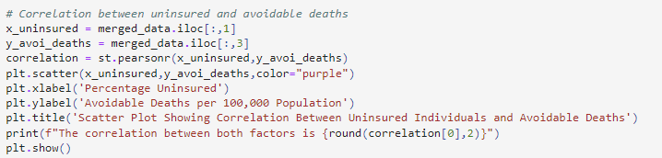
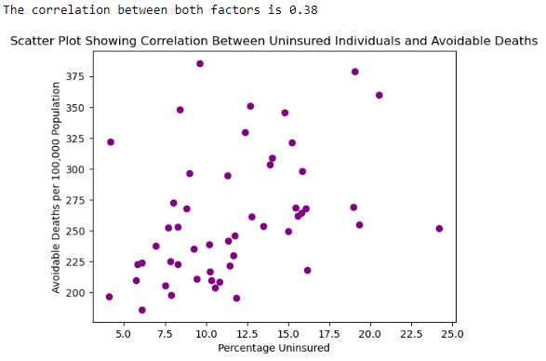
Notes:
We created a scatter plot of our data per state, and measured the correlation between our factors. This plot shows a positive correlation factor of 0.38 between uninsured individuals and avoidable deaths. This shows that not having insurance is a moderate factor to an increase in premature deaths per state.
<next slide>

Slide 11
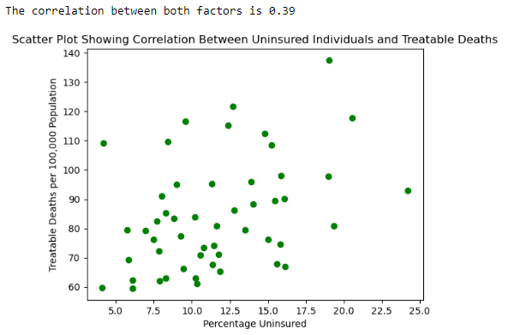
Notes:
We had similar results with the treatable and preventable scatter plots. Interestingly enough, when comparing treatable to preventable, the graphs looked identical to me, but the correlation factor was 0.35 instead of 0.39. It goes to show, the human eye alone isn’t reliable. So we’re glad to have correlation factors for exploration.
<next slide>

Slide 12
Question 1 Conclusion
Is there a correlation between the percentage of uninsured adults and premature mortality rates per state?
Conclusion: Yes, the Pearson correlation factor was between 0.3 and 0.4 for avoidable, treatable, and preventable deaths compared to the percentage uninsured per state. This shows a consistent moderate correlation. Which indicates that having insurance is a factor, albeit unlikely to be the only factor.
Problem: Finding a way to compare percentages to date measured per 100k population as 1-to-1 comparison wasn’t possible. Solution: Pearson correlation factor
Limitations: This comparison is between uninsured adults only and the 100k population that includes children. It’s also important to note this is correlation and not necessarily direct causation.
What we would’ve done differently: We would’ve combined that data with the adults for comparison to the population data. We would also learn how to graph the r line.
Expansion: The moderate correlation indicates there are other factors involved. One such factor might be whether or not having a primary care doctor provides more access to preventable care options.
Notes:
And through correlation, we did conclude not having insurance contributes to a higher number avoidable, preventable, and treatable deaths. This indicated to us that not having insurance potentially prevents seeking any type of health care.
The moderate correlation indicates there are other factors involved. We wanted to focused our efforts specifically on how preventative measures relate to premature mortality. So one factor to explore was having a primary care provider.
Which brings us to our second question, which Tammy will be presenting. Tammy?
<next slide>

Slide 13
02
Which has more influence on health outcomes, not having insurance or not having a primary care provider?
Notes:
Our research showed that having health insurance encourages individuals to seek medical care.
However, we wanted to explore if having a primary care provider was potentially a higher correlating factor so we asked:
Which has more influence on health outcomes, not having insurance or not having a primary care provider?
<next slide>
Research Citation: “In expansion states, people who would otherwise be in the Medicaid coverage gap had increased health insurance coverage, lower rates of avoiding seeking medical care, and greater utilization of certain preventive care measures.”

Slide 14
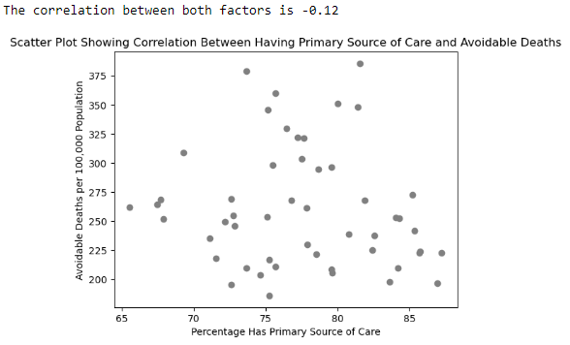
Remember from Question 1:
Correlation between Uninsured Adults and Premature Mortality was between 0.3 - 0.4 (moderate correlation)
By comparison, not having a primary care source does not have as much effect.
Having a primary care source = NOT statistically significant
Notes:
To explore this, compared the correlations we already have (0.3-0.4 moderate correlation between uninsured and increased premature avoidable, preventable, and treatable deaths take a look at this comparison
-Having a Primary care source and Preventable deaths and one for Primary Care source and avoidable deaths. It had very low correlation of -0.12
From here we decided to look at Primary Care source and Uninsured Adults
The correlation factor comparing the percentage uninsured to each of the premature mortality datasets (avoidable, preventable, and treatable deaths) showed the correlation factor between positive 0.3 and 0.4. It’s low enough it’s certainly not the only factor, but certainly there is a strong indication not having insurance contributes to higher premature mortality.
Whereas comparing each of the premature mortality data sets to the percentage of adults that have a primary care provider, there was a very small correlation.
By comparison, we can conclude not having insurance has a larger effect on premature mortality rates per state than not having a primary source of care.
<next slide>

Slide 15
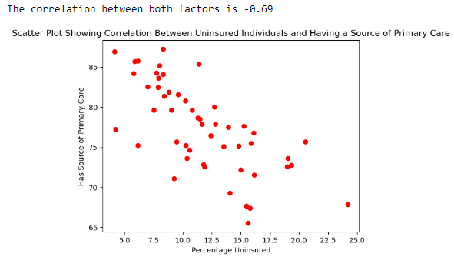
Not having insurance has a strong negative correlation to not having a primary care provider.
Notes:
We found that there was a high negative correlation factor (-0.69) between not having insurance and having a primary source of care. Meaning someone without insurance is less likely to seek care from a primary care source which indicates lack of seeking preventive care.
Which begs the question, does lack of insurance prevent seeking just preventive care, or health care all together?
<next slide>

Slide 16
Question 2 Conclusion
Is there a correlation between the percentage of uninsured adults and premature mortality rates per state?
Conclusion:
Having insurance has a greater impact on lowering premature deaths than having a primary care provider.
0.35, 0.38, 0.39 correlation factors compared to -0.10, -0.12
Not having insurance is a very strong factor in not having a primary care provider.
-0.69 correlation factor
Problem: Finding a way to compare percentages to date measured per 100k population as 1-to-1 comparison wasn’t possible. Solution: Pearson correlation factor
Limitations: This comparison is between uninsured adults only and the 100k population that includes children. It’s also important to note this is correlation and not necessarily direct causation.
What we would’ve done differently: We would’ve combined that data with the adults for comparison to the population data. We would also learn how to graph the r line.
Expansion: The moderate correlation indicates there are other factors involved. One such factor might be whether or not having a primary care doctor provides more access to preventable care options.
Notes:
We concluded having insurance has a greater impact on lowering premature deaths than having a primary care provider. In fact, not having insurance is a is a leading reason to not have a primary care provider. However, While we confirmed having health insurance correlates to less premature deaths, we do not know that it is the highest correlating factor.
We ruled out having primary care doctor as one correlation factor. Our problems at this point was scope crawl, as there are so many factors potentially involved. For example, we could’ve explored differences in state policy and healthcare systems. At this point, we chose to narrow focus by identifying particularly well versus poor performing states.
Which brings us to our third question, which will be presented by Katherine.
<next slide>

Slide 17
03
What are the Best and Worst 5 State Rankings?
Notes:
Our research showed that having health insurance encourages individuals to seek medical care.
However, we wanted to explore if having a primary care provider was potentially a higher correlating factor so we asked:
Which has more influence on health outcomes, not having insurance or not having a primary care provider?
<next slide>
Research Citation: “In expansion states, people who would otherwise be in the Medicaid coverage gap had increased health insurance coverage, lower rates of avoiding seeking medical care, and greater utilization of certain preventive care measures.”

Slide 18
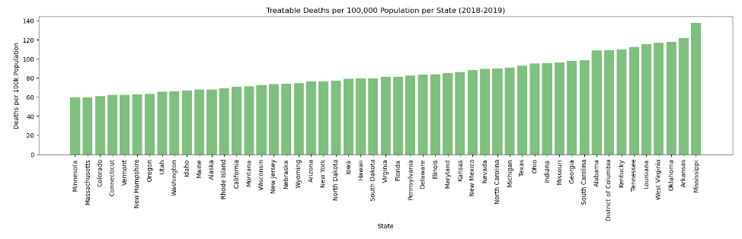
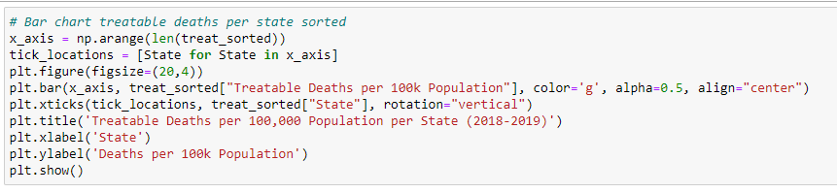
Notes:
We found that there was a high negative correlation factor (-0.69) between not having insurance and having a primary source of care. Meaning someone without insurance is less likely to seek care from a primary care source which indicates lack of seeking preventive care.
Which begs the question, does lack of insurance prevent seeking just preventive care, or health care all together?
<next slide>

Slide 19
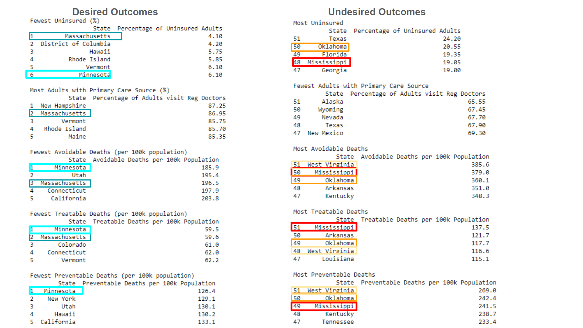
Notes:
We found that there was a high negative correlation factor (-0.69) between not having insurance and having a primary source of care. Meaning someone without insurance is less likely to seek care from a primary care source which indicates lack of seeking preventive care.
Which begs the question, does lack of insurance prevent seeking just preventive care, or health care all together?
<next slide>

Slide 20
PROJECT NEXT STEPS
Looking into trending states for what factors lead to premature mortality:
Conclusion:
2018-2019
Best Outcomes:
Massachusetts
Minnesota
Additional Potential Paths:
How has this changed since covid?
Break down states further into regions (rural, urban) to explore accessibility of health care
Utilization of preventive screenings
Worst Outcomes:
Mississippi
Oklahoma
West Virginia
Notes:
We concluded having insurance has a greater impact on lowering premature deaths than having a primary care provider. In fact, not having insurance is a is a leading reason to not have a primary care provider. However, While we confirmed having health insurance correlates to less premature deaths, we do not know that it is the highest correlating factor.
We ruled out having primary care doctor as one correlation factor. Our problems at this point was scope crawl, as there are so many factors potentially involved. For example, we could’ve explored differences in state policy and healthcare systems. At this point, we chose to narrow focus by identifying particularly well versus poor performing states.
Which brings us to our third question, which will be presented by Katherine.
<next slide>

Slide 21
CONCLUSION
Lower percentage of uninsured adults correlated with fewer avoidable, treatable, and preventable deaths per state.
Pearson’s correlation coefficient between 0.3 - 0.4. Moderate correlation for all data sets.
Negative correlation (-0.69) between uninsured adults and not having a primary care provider
Emphasizes the positive impact of health insurance on seeking preventative medical care
Identified two states with trending positive healthcare outcomes, and three states trending negative healthcare outcomes.
Best: Massachusetts, Minnesota | Worst: Mississippi, Oklahoma, West Virginia
Starting point for expansion into different factors influencing healthcare outcomes at the state level
Limitations:
The analysis is based on data from 2018-2019, which represents a relatively short time frame and does not include trend analysis over time.
Does not reflect changes since covid pandemic.
Having a primary care provider does not equal regular doctor visits
The uninsured correlations only included adults, not uninsured children
What would we do differently?
Combined the children and adults data sets for uninsured and compared adult-only, child-only, and the combination.
Limit the premature death factor to 1 data set and instead explored additional factors.
Notes:
We concluded having insurance has a greater impact on lowering premature deaths than having a primary care provider. In fact, not having insurance is a is a leading reason to not have a primary care provider. However, While we confirmed having health insurance correlates to less premature deaths, we do not know that it is the highest correlating factor.
We ruled out having primary care doctor as one correlation factor. Our problems at this point was scope crawl, as there are so many factors potentially involved. For example, we could’ve explored differences in state policy and healthcare systems. At this point, we chose to narrow focus by identifying particularly well versus poor performing states.
Which brings us to our third question, which will be presented by Katherine.
<next slide>

Slide 22
Healthcare entrepreneurship graph
60%
25%
Mars
Saturn
Despite being red, Mars is a cold place
Saturn is a gas giant and has rings
40%
95%
Jupiter
Neptune
Jupiter is the biggest planet
Neptune is far away from us

Slide 23
Instructions for use
If you have a free account, in order to use this template, you must credit Slidesgo by keeping the Thanks slide. Please refer to the next slide to read the instructions for premium users.
As a Free user, you are allowed to:
Modify this template.
Use it for both personal and commercial projects.
You are not allowed to:
Sublicense, sell or rent any of Slidesgo Content (or a modified version of Slidesgo Content).
Distribute Slidesgo Content unless it has been expressly authorized by Slidesgo.
Include Slidesgo Content in an online or offline database or file.
Offer Slidesgo templates (or modified versions of Slidesgo templates) for download.
Acquire the copyright of Slidesgo Content.
For more information about editing slides, please read our FAQs or visit our blog:
https://slidesgo.com/faqs and https://slidesgo.com/slidesgo-school

Slide 24
Contents of this template
You can delete this slide when you’re done editing the presentation
Fonts | To view this template correctly in PowerPoint, download and install the fonts we used
Used and alternative resources | An assortment of graphic resources that are suitable for use in this presentation
Thanks slide | You must keep it so that proper credits for our design are given
Colors | All the colors used in this presentation
Icons and infographic resources | These can be used in the template, and their size and color can be edited
Editable presentation theme | You can edit the master slides easily. For more info, click here
For more info: SLIDESGO | BLOG | FAQs
You can visit our sister projects: FREEPIK | FLATICON | STORYSET | WEPIK | VIDEVO

Slide 25
THANK YOU

